Slide 1
Creating your first Visualizations and Dashboard
CSIS 3860 Data Visualization
By
Rupa Manabala

Slide 2
agenda
Traditional Information Analysis – the shortcomings
The Business Case for Visual Analysis
Tableau’s Desktop Tools
The Tableau Desktop Workplace
Connecting to your data
Foundations for building visualizations
Visualizing data
Building your dashboard
Notes:
Reading required – Chapters 1 and 2 of the textbook.

Slide 3
Traditional BI tools – Shortcomings
BI Tools – accessible but not used
Tools – too difficult to use and learn
Technical skills – minimal
Longer turnaround time
Spreadsheets for analysis and reporting
Notes:
Companies have access to the available BI tools rarely use them for analysis and reporting. Only 8 – 11% of the companies use these tools. (The BARC society report).
Those companies that use these tools find that it is too difficult for their technical staff to use and learn, mainly because the technical staff have minimal or no skills to use these tools.
The turnaround time for generating reports is longer than anticipated with the use of these traditional tools.
Surprisingly, the companies that have adopted certain BI Tools are still using Spreadsheets for analysis and reporting. This poses issues in its won as there is a potential for incorrect reporting and this could lead inappropriate analysis and eventually mis-informed decision making.

Slide 4
Shortcomings – Cont’d
Stephen Few –
Inappropriate visualizations provided by legacy vendors
Mismatch of skills and their use
Impact
Reliable information and decision making
The tools have a huge responsibility
Solution
Tableau
industrial-strength reporting, analysis and discovery
Notes:
Stephen Few is an author and has written several books to highlight the problem of incorrect visualizations. He also provided examples of data visualizations that adhered to best practices He believes that skills needed for creating /designing data base tools are the not the same as that required to create dashboards that communicate efficiently.
Tableau is an amazing data visualization platform where you will be able to achieve incredible data discovery, data analysis, and data storytelling.

Slide 5
The Business Case for Visual Analysis
Business – Profit or Non-profit oriented
Monitor operations and perform analysis
Analyses and Reports are used to:
Maintain efficiency
Pursue opportunity
Prevent negative outcomes

Slide 6
Three types of Data
Type 1
Type 2
Type 3
Known Data
Data you know you need to know
Data you don’t know you need to know
Notes:
Type 1 – Known data : available in daily, weekly, and monthly reports. Used for monitoring. Purpose – visibility of operations
Type 2 – feeding from the patterns and outliers from Type 1 data, “Why is this happening?” Traditional reporting tools provide framework to provide answers to this kind of questions (if the design of the reports anticipated this questions)
- Type 3 – Performing apt analysis of data in real time with visual analytics provides an opportunity to see patterns and outliers that are not visible in Type 1 and Type 2 reports. Interacting in real time can lead to new and quick actionable insights.

Slide 7
Visual Analytics
Appropriate Analytics Improve decision making by:
Highlighting important outliers
Making these outliers easier to see
Interactive Analytics
Make those details come to life
Help the audience to explore areas of interest

Slide 8
Visual Analytics – Cont’d
Attributes of an ideal reporting and analysis tool are:
Simplicity
Connectivity
Visual competence
Sharing
Scale
TABLEAU – Designed to address these needs
Notes:
Attributes of an ideal analysis and reporting tool:
Simplicity – should be simple and easier to learn even for non technical users to work around
Connectivity – should be able to connect to large variety of data sources seamlessly involving minimal user intervention.
Visual Competence – the tool should be able to produce multiple or various appropriate visuals or graphics by default or by demand
Sharing – should be able to help the user to share the insight
Scale – the tool should be ready to handle growing size of already huge datasets.

Slide 9
Tableau
Analysis is similar to art
Tableau’s Design:
Encourages interaction with data
Encourages Implementation
Gives Speedy Feedback
Provide an expressive experiment
Give users control
Tableau uses VizQL – a Visual Query Language
Notes:
Tableau Is an amazing data visualization tool. It is unique among all other data visualization tools because it uses VizQL, a visual Query Laguage. The user need not write a lot of SQL or MDX or painstakingly work through wizards to select a chart type and then link components together with data.(Milligan, 2015)
The user interacts with the data in a visual environment and Tableau converts the users action into necessary queries automatically. Much of the actions involve drag and drop.
Milligan, Joshua N. (2015). Learning Tabelau.(1 Ed.). Brimingham: Packt Publishing.

Slide 10
Tableau Desktop Tools
The design tool to create visual analytics and dashboards
Personal Edition
Professional Edition
Open Database Standard (ODBC) – Connector to connect to specific data for access
Tableau – Personal – Connects to data sources locally
Tableau Professional – Personal edition features and much more
Notes:
Tableau Desktop comes in two editions: Personal and Professional. Professional Edition has capability to connect to variety of data sources than Personal edition.
ODBC is used to connect to data sources that do not have a connector.
Tableau Personal supports - Excel, Access, Text (.csv), Odata. Microsoft Windows Azure, Marketplace DataMarket, and Tableau Data Extract (.tde) files.
Tableau Professional supports – data sources supported by Personal Edition and
Relational databases, columnar-analytic databases, data appliances, NoSQL data sources, web-service APIs, and other ODBC-3 compliant data sources.
Tableau Reader does not need a licence to work with
Tableau Online Help (TOH) – readily available for users to access the huge repository of information readily available at hand and updated by active participants frequently.

Slide 11
Tableau File Types
Save and share data using different file types
Difference lies in the amount and type of information being stored
Default save method creates .twb – Tableau Workbook file
Save as option - .twbx – Tableau Packaged Workbook
Other types:
Tableau Data Source - .tds
Tableau Data Extract - .tde
Tableau Book Mark -- .tbm
Tableau Packaged Data Source - .tdsx
Notes:
Please refer to Table 1-1 Tableau File Types of the Textbook.

Slide 12
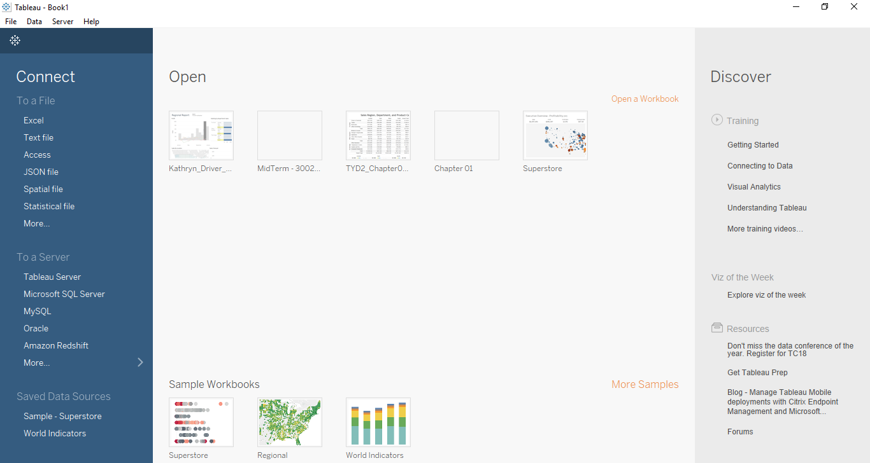
Introducing the Tableau Workspace
Notes:
To learn more about Tableau Workspace, start your Tableau Desktop application, press F1 (Windows) or Shift+Command+7 (Mac) to go to Tableau’s Online manual. Go to Tableau Help Menu and select the Watch Training videos option Use the training videos alongside the textbook to help you strengthen your skills and learning.
The following training video introduces you to the Tabelau Workspace and connecting to your Data source:
https://www.tableau.com/learn/tutorials/on-demand/getting-started?edition=pro&lang=en-us&version=10.2.1&__fullversion=10200.17.0328.0755&platform=windows&status=buy&reg-delay=true

Slide 13
Workspace – Cont’d
Tableau workspace Menu Options:
File – New, Open, Save, Save As, Print, Export – Standard Windows
Data – Paste, Tableau Data Server, Edit Relationships, and Replicate Data Source
Worksheet
Story
Analysis
Map
Format
Server
Windows
Help, and much more

Slide 14
Data Types and Aggregation
Data Types
Text Values
Date Values
Date and time values
Numerical Values
Geographic values
Boolean Values
Aggregations
Sum
Average
Median
Count
Count Discount
Minimum
Maximum
Percentile
Standard Deviation
Variance
Attribute
Dimension

Slide 15
Foundations for building visualizations
Data and Analytics panes
Data Pane
Data Source Connections(s), and
Fields of the data source:
Measure(s), and
Dimensions
Analytics Pane
Summarize
Model
Custom

Slide 16
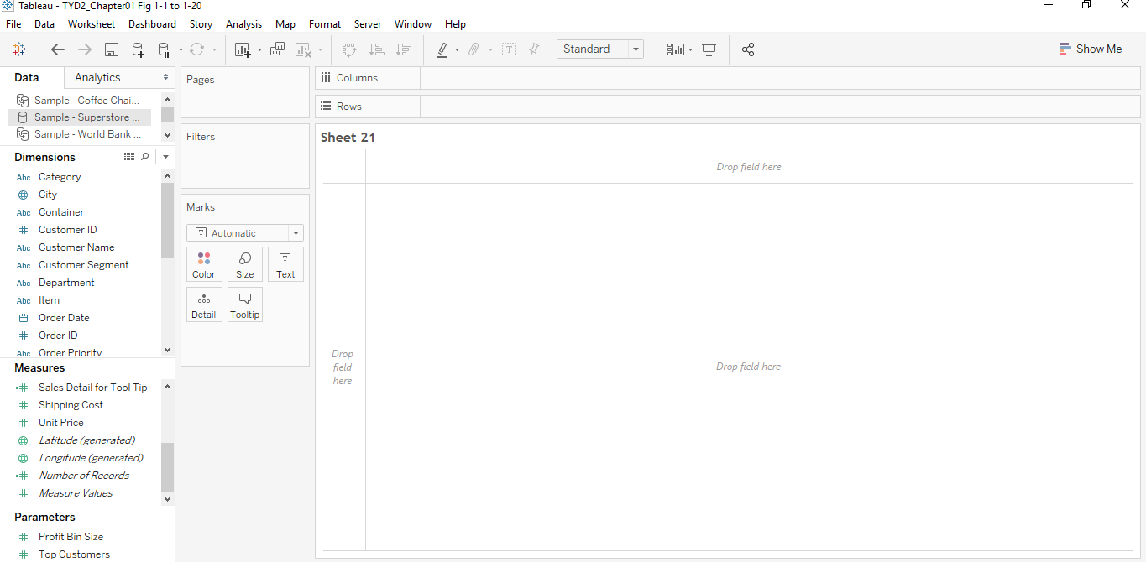
Workspace
Notes:
Pages, Filters, Columns, Rows, Color, Size, and Text are Shelves that allow the user to drag and drop fields from the Data Window.
The Canvas ( sometimes also called as the View or Visualization) – this is the place where Tableau will draw visualization based on where you drag and drop the fields. You can also drag and drop fields directly onto the canvas too.

Slide 17
Dimensions and Measures
Common assumption – Blue for Dimensions and Green for Measures
Discrete Fields
Blue color – values are shown as separate and distinct
Continuous fields
Green color – values are shown as flowing from one value to the other
By Default – Dimensions are mostly discrete and Measures are continuous
Any field, dimension or measure, can be used a continuous or discrete field
Notes:
Dimensions – Contains fields that are text, date, geographic, and other non-calculated fields
Measures – contains numbers and other calculated fields

Slide 18
Visualizing your data
Purpose
Approach data with well defined questions
Explore
Make new discoveries
Types of Visualizations
Bar Charts
Extended Bar Charts – Deeper analysis
Line Charts
Extended Line Charts – Deeper analysis
Geographic Visualizations
Filled Maps
Symbol Maps

Slide 19
Building Your Dashboard
Hands – On Exercise
Data – Coffee Chain / Superstore / data source of your choice
Remember:
You can visit Tableau Online Learning Tutorials and videos anytime

